Slide 1
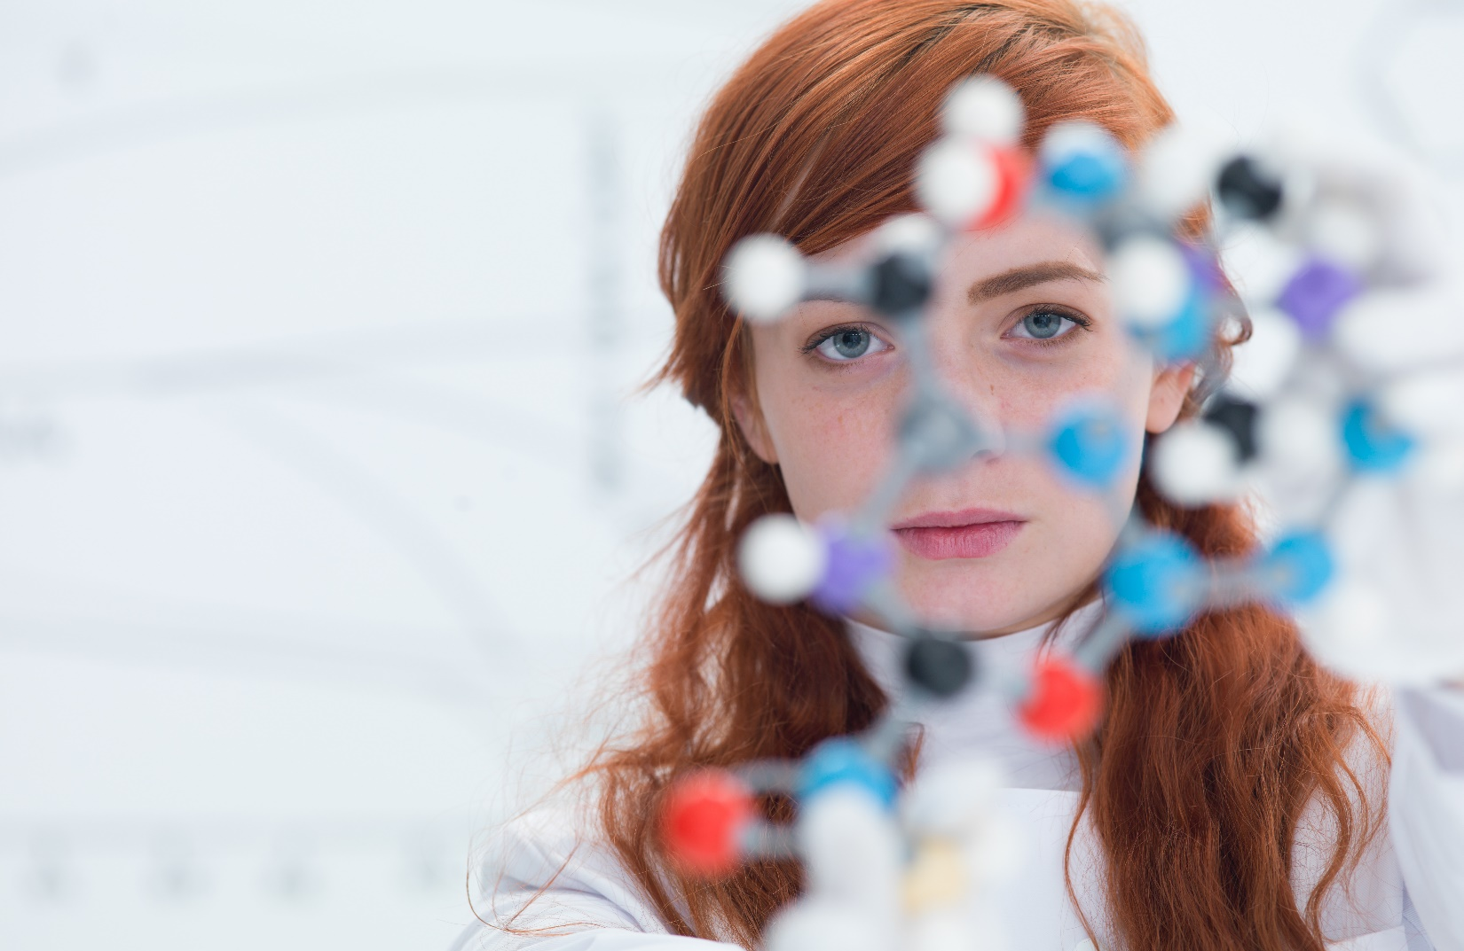

School of Pharmacy and Medical Sciences
Toxicology (MSc)
Toxicology is the study of poisons, drawing heavily on life and physical sciences, as well as being an applied practically-based subject. The purpose of this course is to provide students with a firm foundation in the theoretical and applied aspects of Toxicology which will enable them to pursue a career in this important and rapidly changing field.
Why study Toxicology at Galway?
Global prosperity and health care relies upon the safe use of chemicals in industry, agriculture and medicine. This means toxicologists play a range of vital scientific, industrial and societal roles that are important for the modern world and that a training in toxicology can be the start of a great career. Our graduates have found employment in technical or research roles either in hospitals, universities, in the healthcare industry, and in regulatory bodies, within or outside of Ireland.
Course level: Level 9
Duration: 1 year, full-time
Entry Requirements: Successful students will hold at least a Second Class Honours Level 8 degree, or equivalent international qualification, from a scientific discipline. Students are also considered who have a Level 7 degree, or equivalent international qualification, and three years’ relevant postgraduate full-time work experience. IELTS score of 6.5+ (with not less than 6.0 in any one component).
https://www.universityofgalway.ie/courses/taught-postgraduate-courses/toxicology.html#course_fees
Apply at: https://www.universityofgalway.ie/courses/how-to-apply/. Selection of candidates is based on academic achievement, personal statement in the application,
and performance at interview.
Closing date: There is no set deadline and offers will be issued on a continuous basis.
Contact information / Enquiries to:
Dr Howard Fearnhead
| T +353 91 495 240 | Email howard.fearnhead@universityofgalway.ie |
https://www.universityofgalway.ie/courses/taught-postgraduate-courses/toxicology.html

