Slide 1
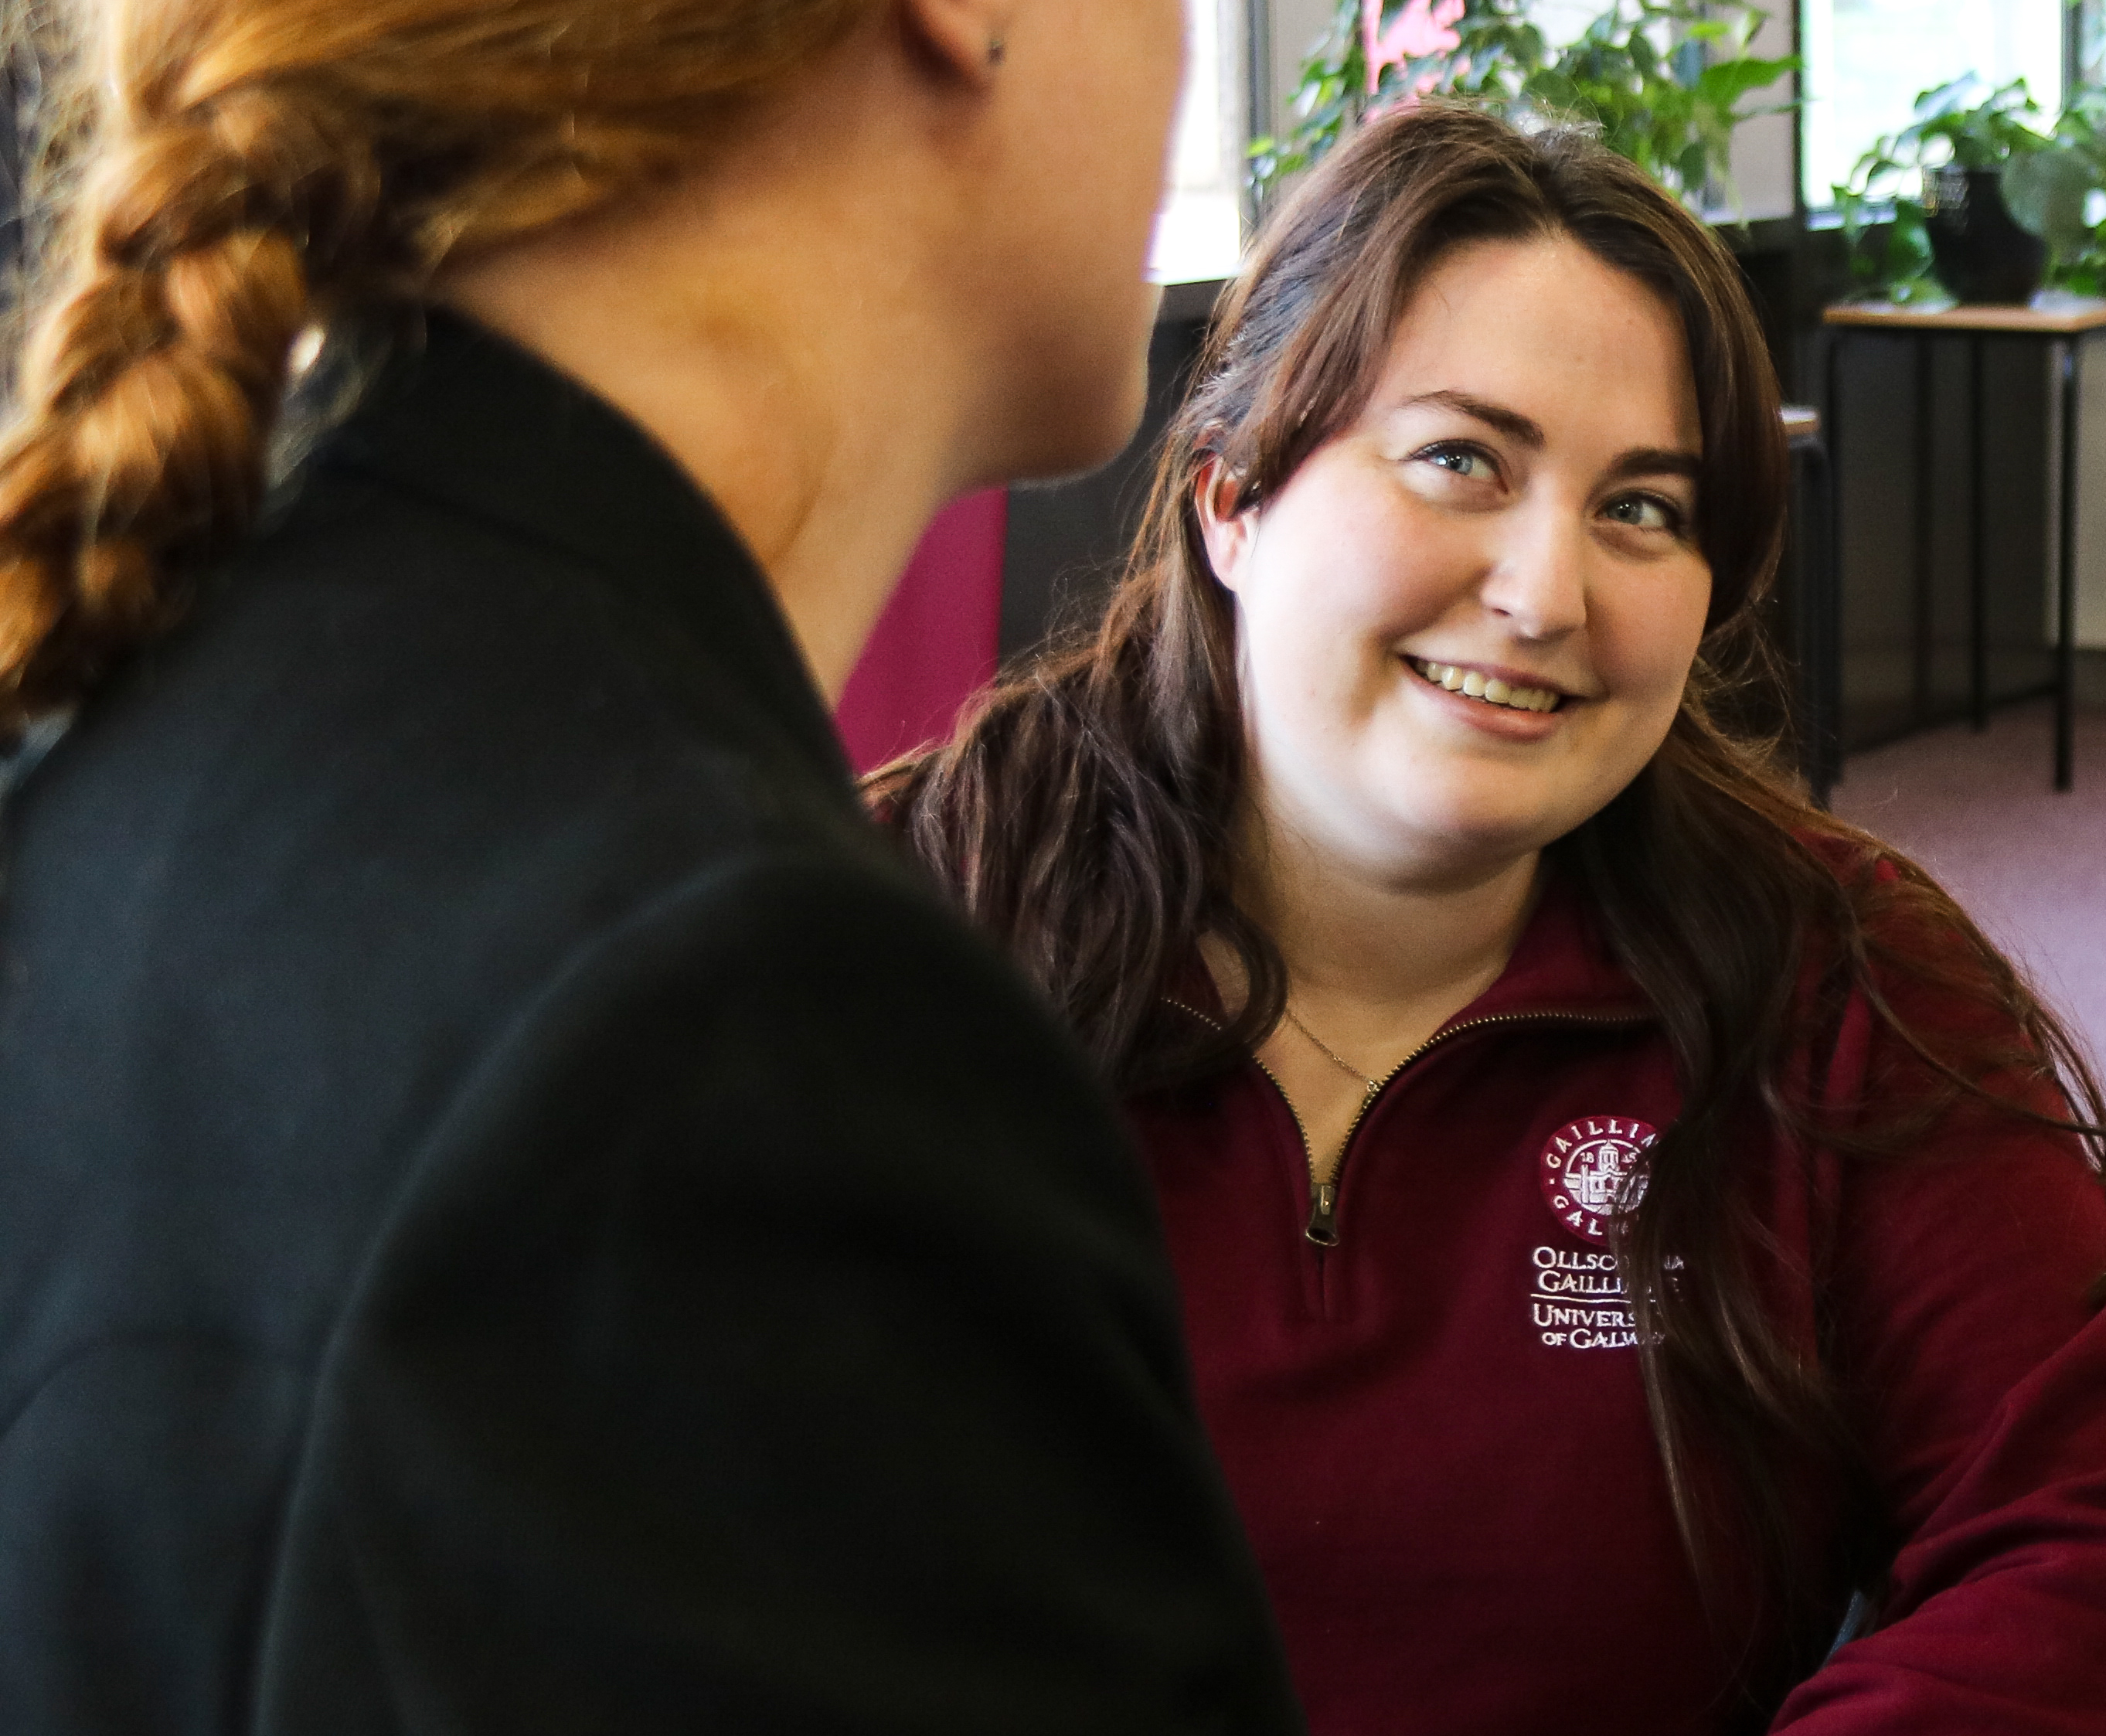
Welcome to
The Library

Slide 2

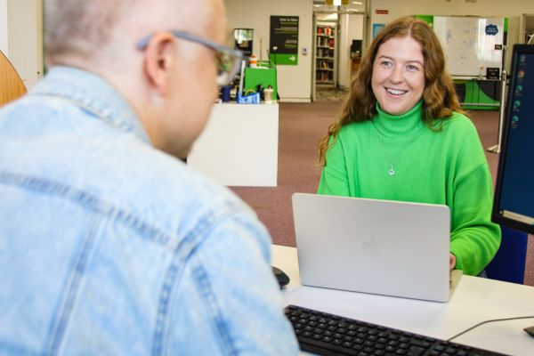
Welcome!
You are very welcome to the University of Galway and its Library.
This is your library. It is a friendly and welcoming space, your gateway to scholarly information, and a source of supports and services that will help you on your academic journey.

Slide 3
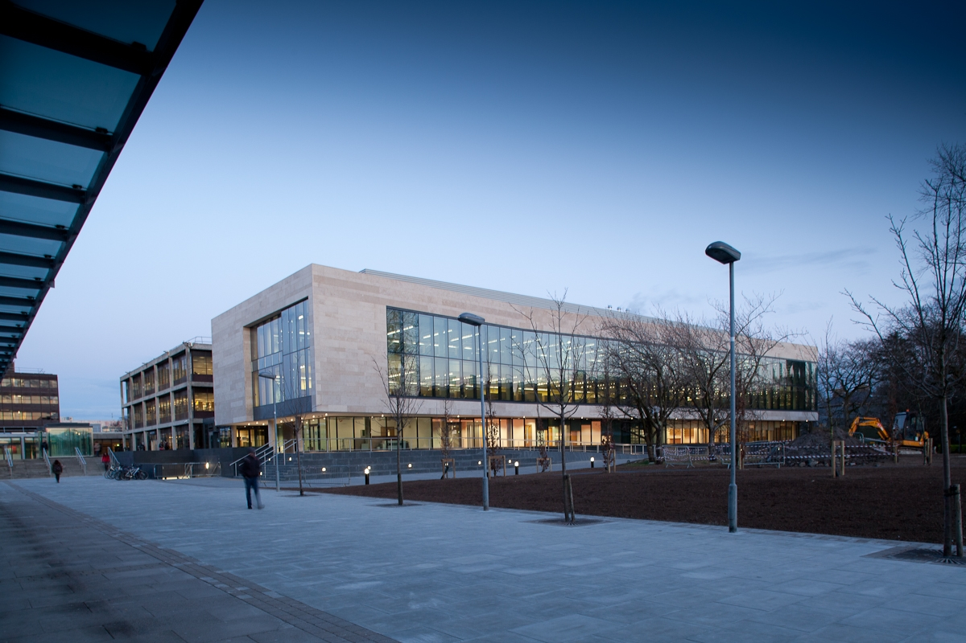
The Main Campus Library is located within the Hardiman Building, adjacent to the Concourse in the South Campus.
Library Website: https://library.universityofgalway.ie/

Slide 4
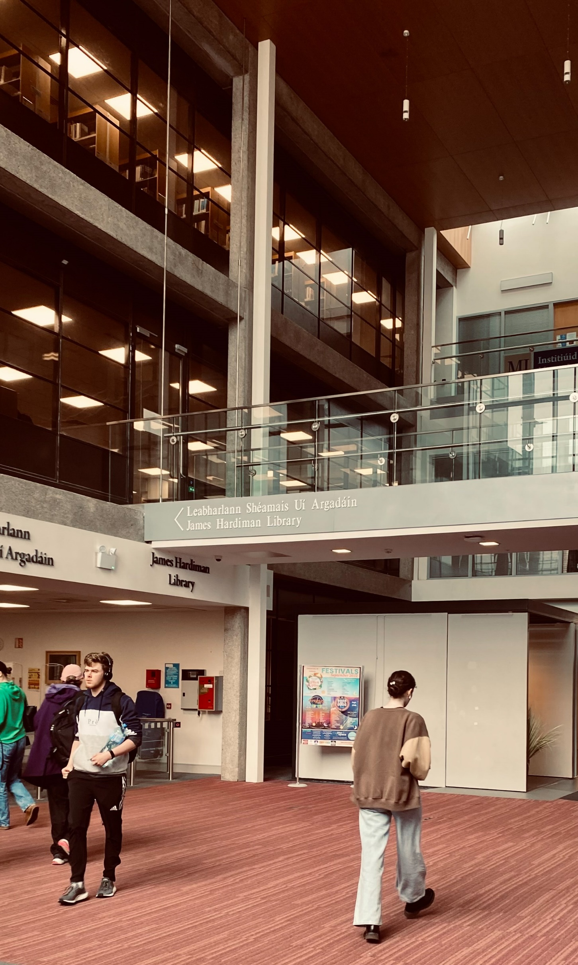


Opening Hours
Main Campus Library:
Monday – Friday: 08:30 – 22:00
Saturday: 08:30 - 17: 30
Sunday: 10:00 – 17:30
Main Campus Library
Monday – Friday: 08:30 – 22:00
Saturday: 08:30 - 17:30
Sunday: 10:00 – 17:30

Slide 5
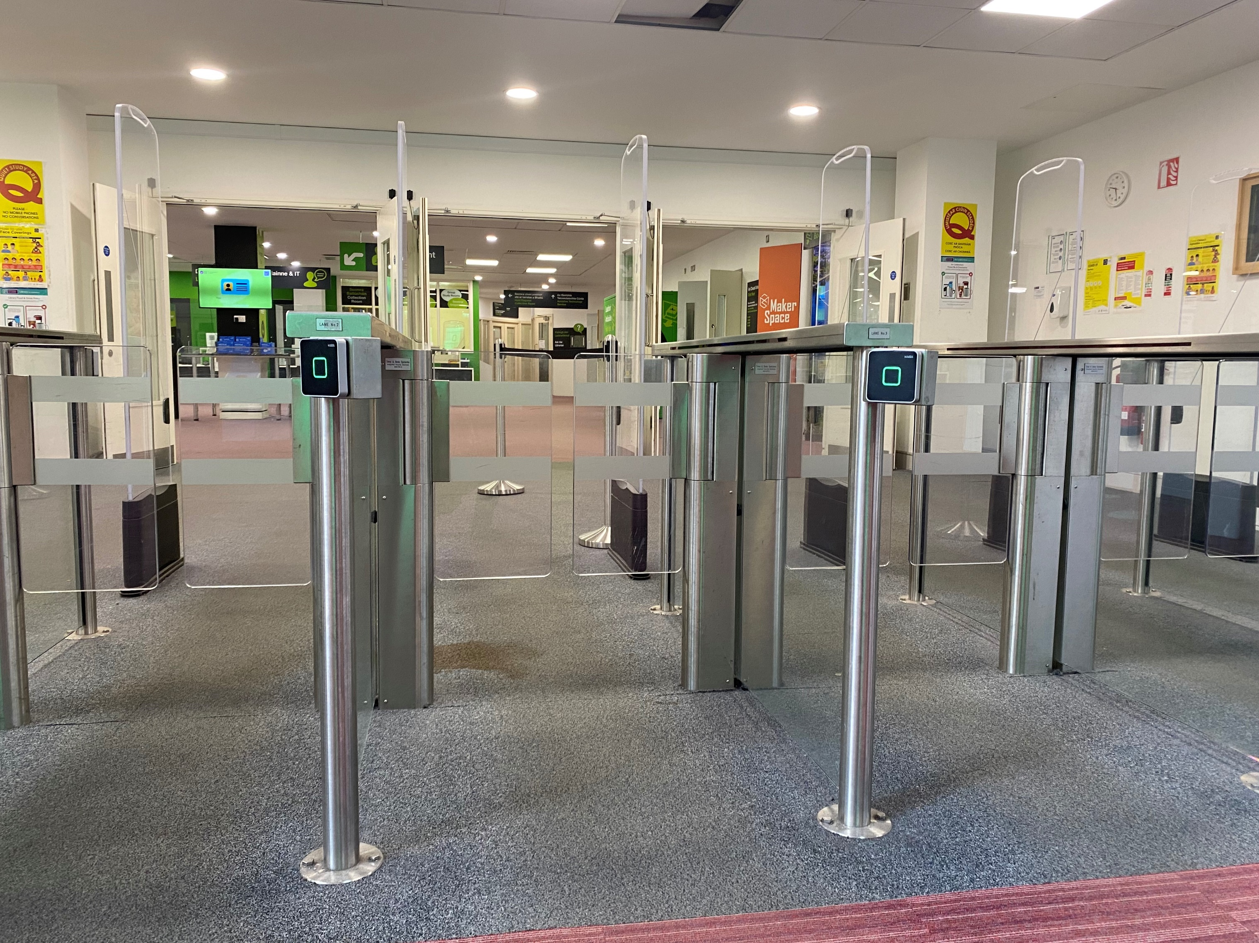
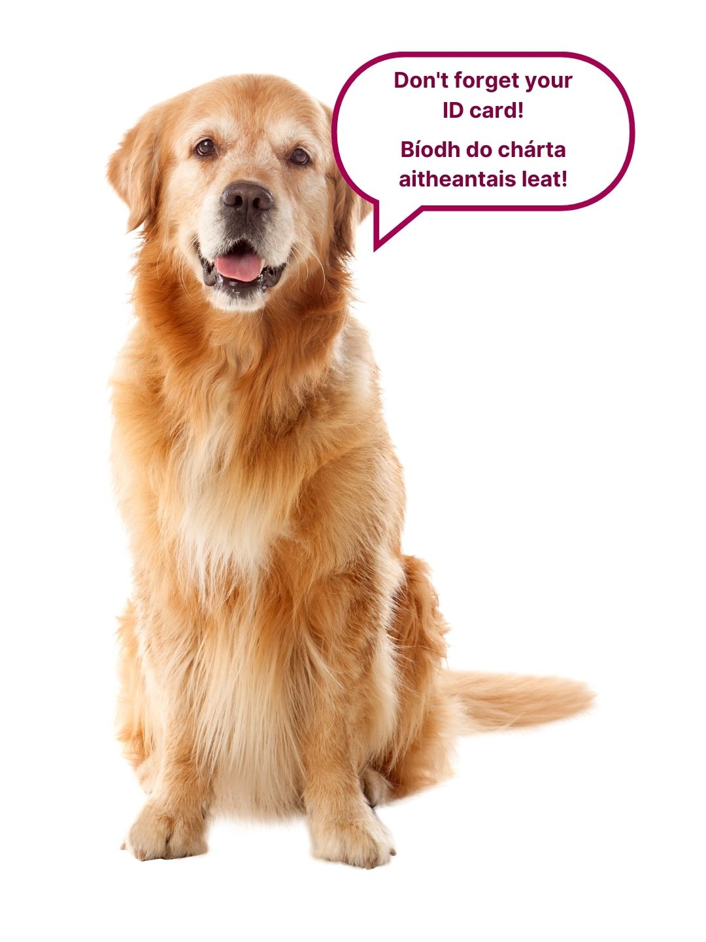
Notes:
You will need your student card to enter and exit the library.

Slide 6
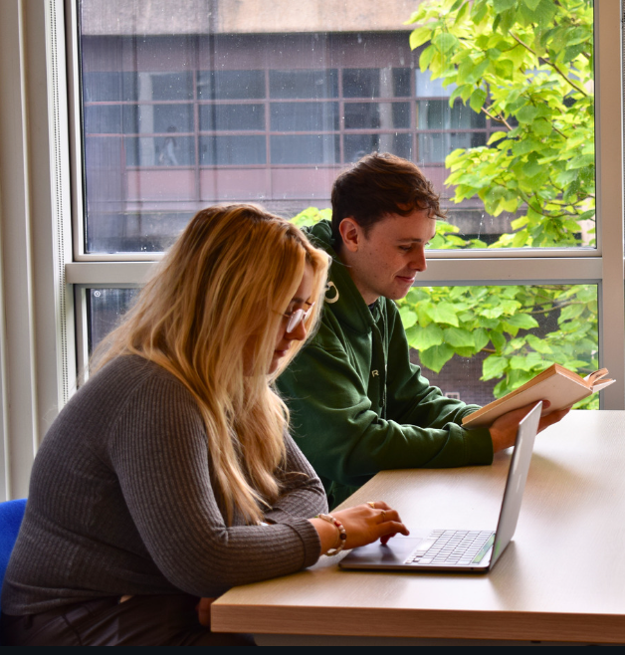
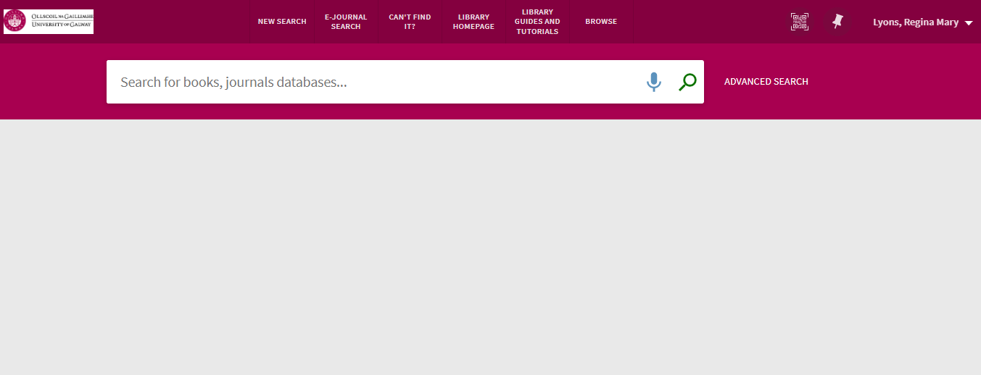

Supporting Your Academic Success...
Access to millions of academic and scholarly resources such as books and journal articles that your lecturers will expect you to use in your essays and assignments.
Home screen of the Library Catalogue. Visit https://library.universityofgalway.ie/ and click Login in the top right-hand corner.

Slide 7
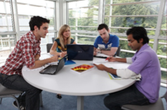
Support services for further assistance in specific areas such as help finding resources
or academic writing .
A quiet place to study.
Group Study Rooms for group work
(need to book).
Photocopying and Printing Facility
(details of how to put credit on your account available on the Library Website).
This is your library and we are here to help you!

Slide 8
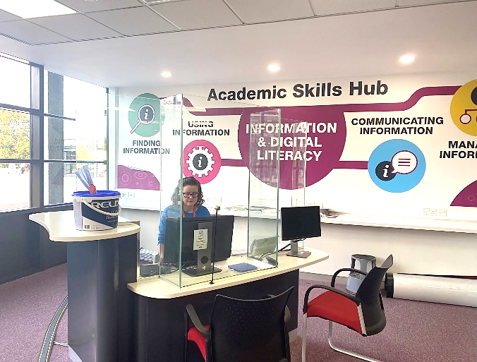
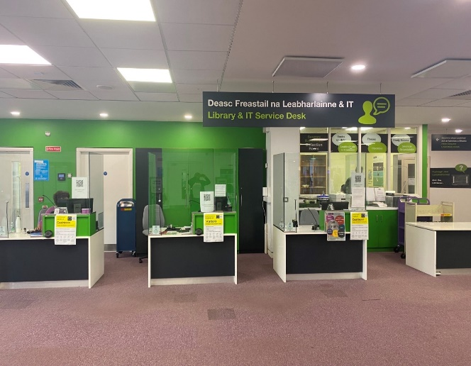
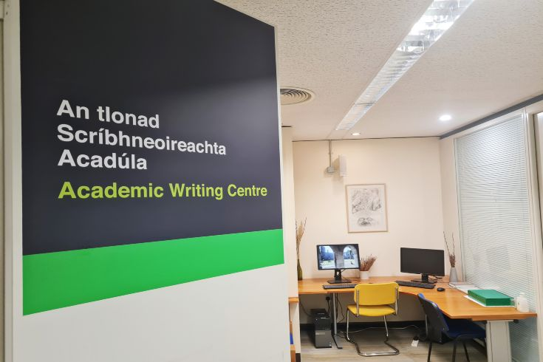
Services and Supports
Check out the “Studying” tab on the Library Website, there is lots of information and resources available there
Academic Skills Team: support all Undergraduate and Taught Master’s Students in finding, using, and managing information
Academic Writing Centre: provide one-on-one tutorials and email consultations on essay writing
Library & IT Service Desk: advice on all Library services and collections and a wide range of IT services
MakerSpace: be creative, collaborate, share develop ideas, innovate, 'make stuff’!
Notes:
Info on the slide.

Slide 9
Orientation Supports
Get Connected Desk
  Sept 8th – 19th: Open M-F; 10:00 – 16:00
  Help with Library services, email, Canvas, printing and more!
Library Tours
  M-F 10:00, 13:00, 14:00, 15:00
Library Tours for Neurodiverse Patrons:
  Friday 12 September, 10:00
  Friday 19 September, 10:00
  Quieter tours for neurodiverse students. Sunglasses, hats, and fidget gadgets are welcome. Noise cancelling headphones are available to borrow.
Notes:
Info on the slide.

Slide 10



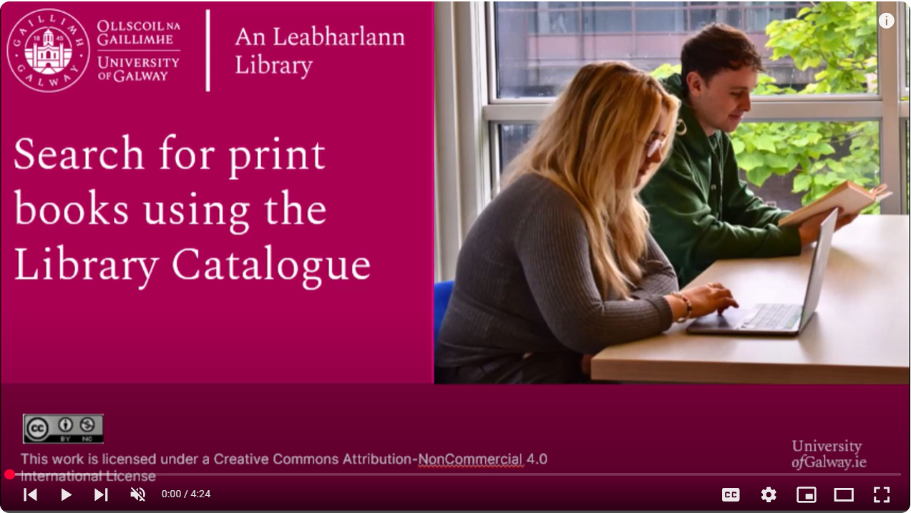
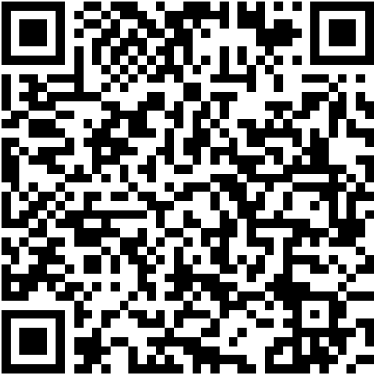
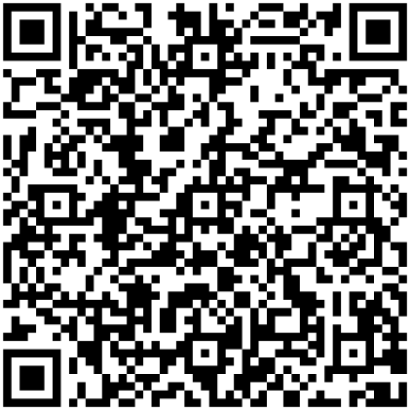
Library Resources
First Year In: FYI
Research Skills for Students
Academic Integrity
Master the Library Catalogue
https://library.universityofgalway.ie/studying/academicskills/

Slide 11
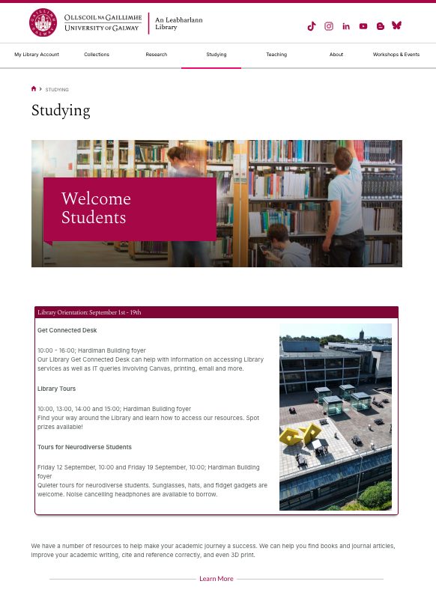
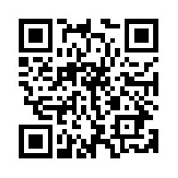
Getting Started in the Library https://library.universityofgalway.ie/studying/

Slide 12




Phone
(091) 49 3399
Email
library@universityofgalway.ie
Instagram
uniofgalwaylib
TikTok
uniofgalwaylib

Slide 13
Go raibh maith agat!
Thank you!

